Slide 1

Unity Game Engine
Ante Zovko

Slide 2





Introduction to unity
How to download
History
How to use
Competitors
General Review

Slide 3
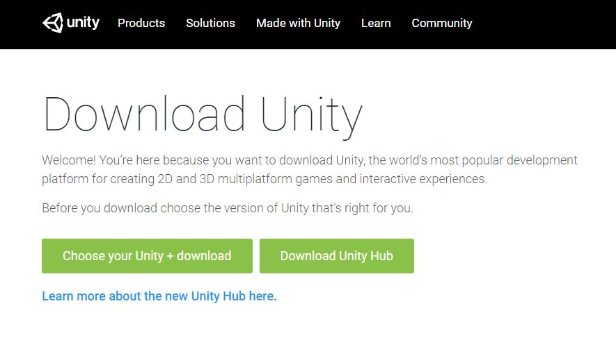
How To download
Google: “Unity Download”
Choose between a specific version or Unity hub
Unity Hub highly recommended

Slide 4
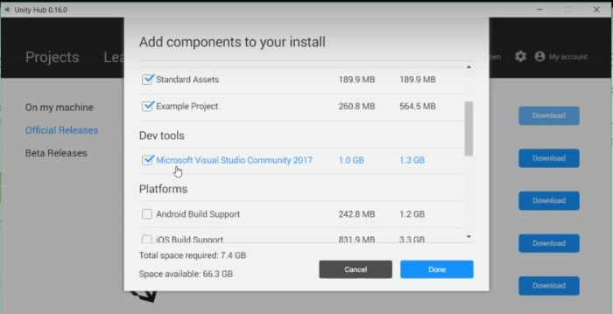
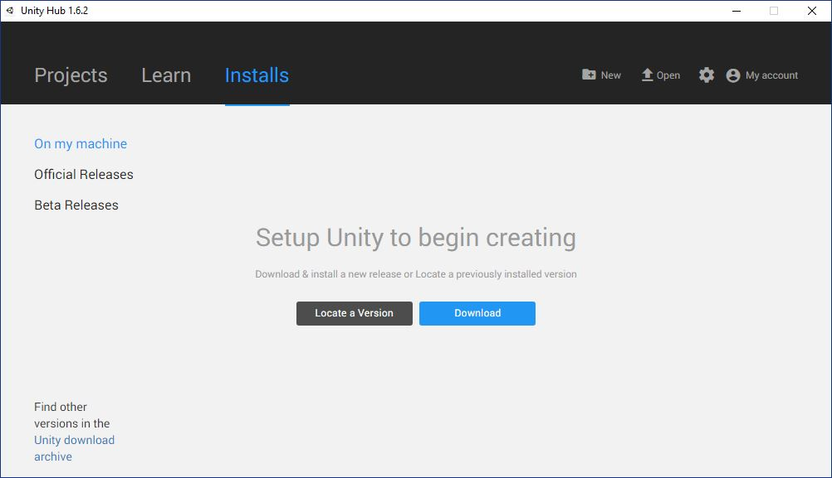
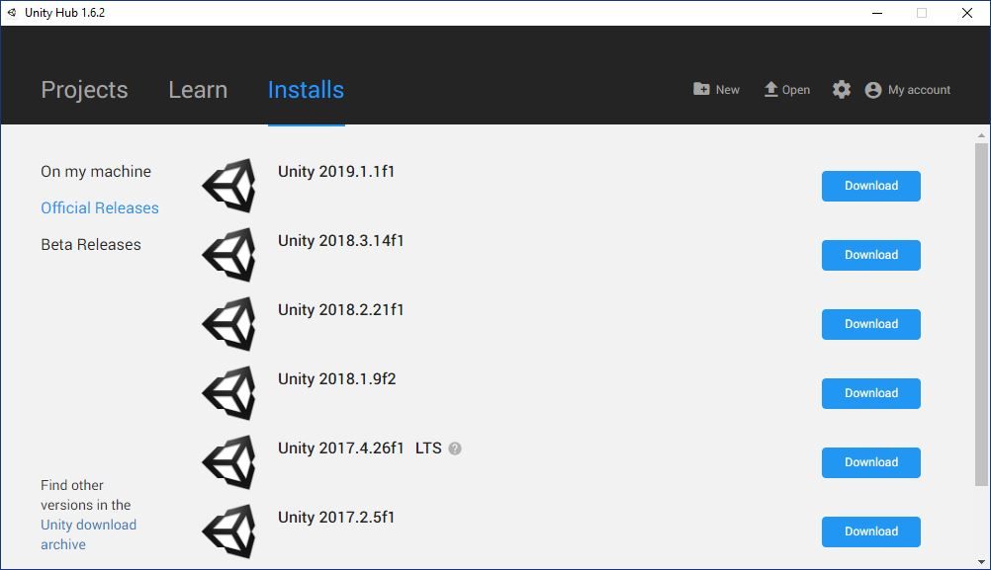
How to download

Slide 5
Introduction to unity
How to download
History
How to use
Competitors
General Review

Slide 6
History
What is unity?
Unity is a cross-platform real-time engine developed by Unity Technologies.
It can be used to create both 3D and 2D games.
It was launched in 2005
As of 2018, Unity includes a fully-supported, modern .NET runtime
Programming Language(s)
First language supported was “Boo”
Boo was dropped in Unity 5 due to a small userbase
A version of JavaScript called “UnityScript” was used until 2017
In 2017, Unity removed support for all other languages in favor of C#

Slide 7
Availability
The Unity Editor is available on Windows, Mac OS, and Linux
The latest version is 2019.1.1
Supported Platforms
The engine supports games for 29 different platforms
Windows, Mac OS, Android, iOS, PlayStation 4, Xbox One, Wii U…
Since version 5, Unity offers the WebGL Bundle compiled to JavaScript

Slide 8
Introduction to unity
How to download
History
How to use
Competitors
General Review

Slide 9
How to use
New Project
Simple GUI for a game
Scripts
Final product

Slide 10
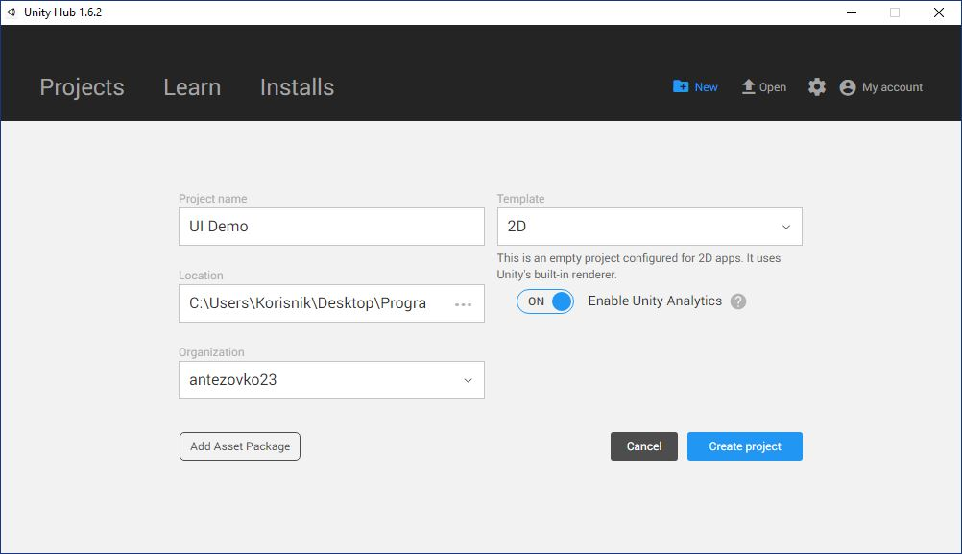
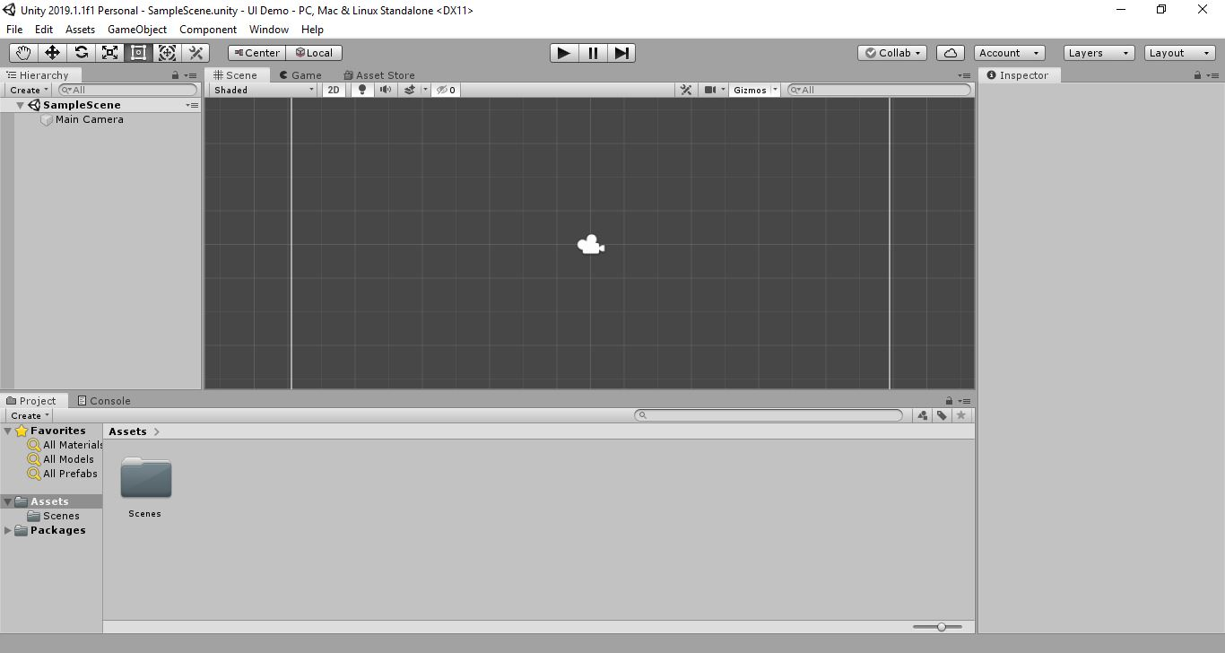
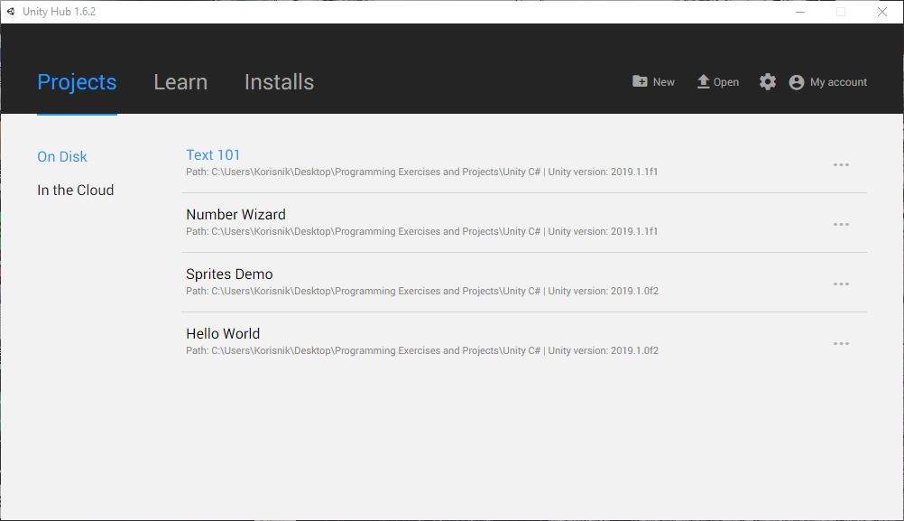
How to use
Creating a New Project

Slide 11
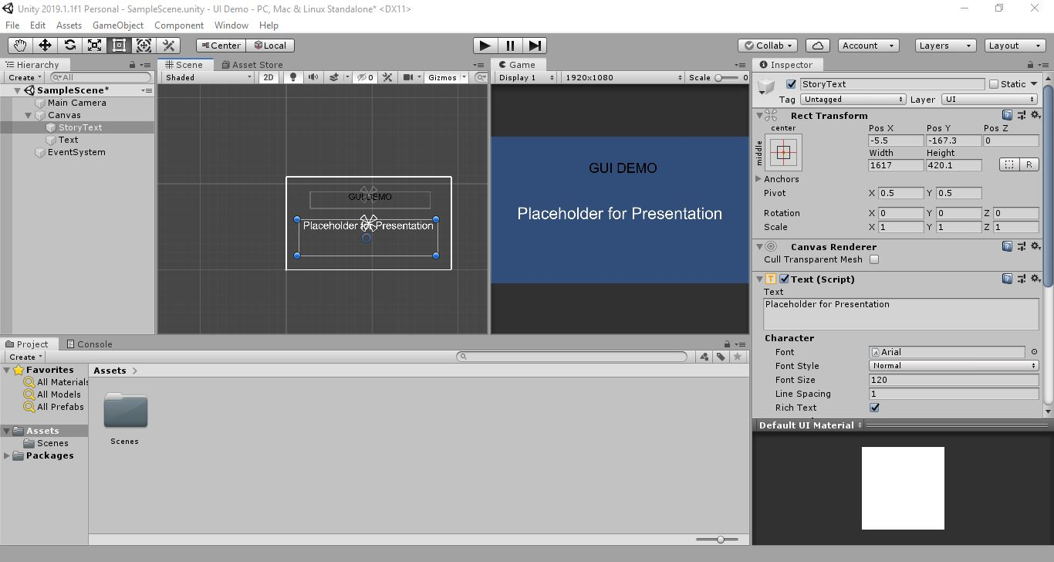
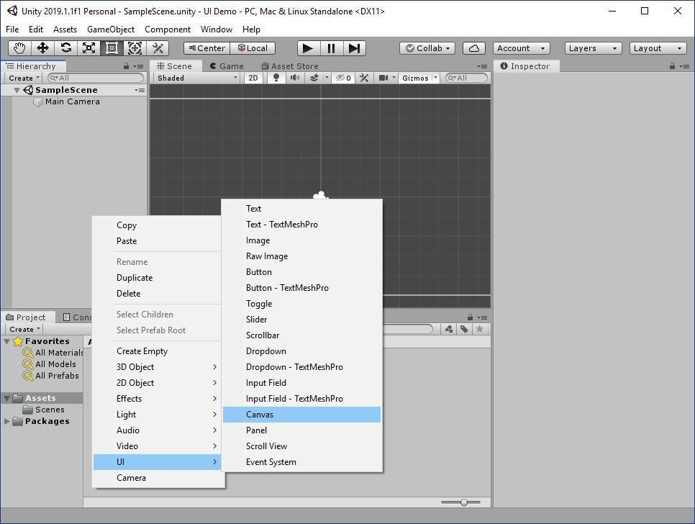
How to use
Simple GUI For a game

Slide 12
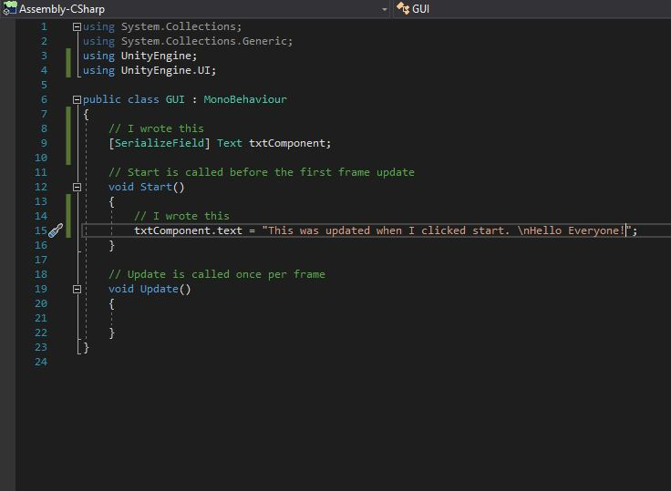
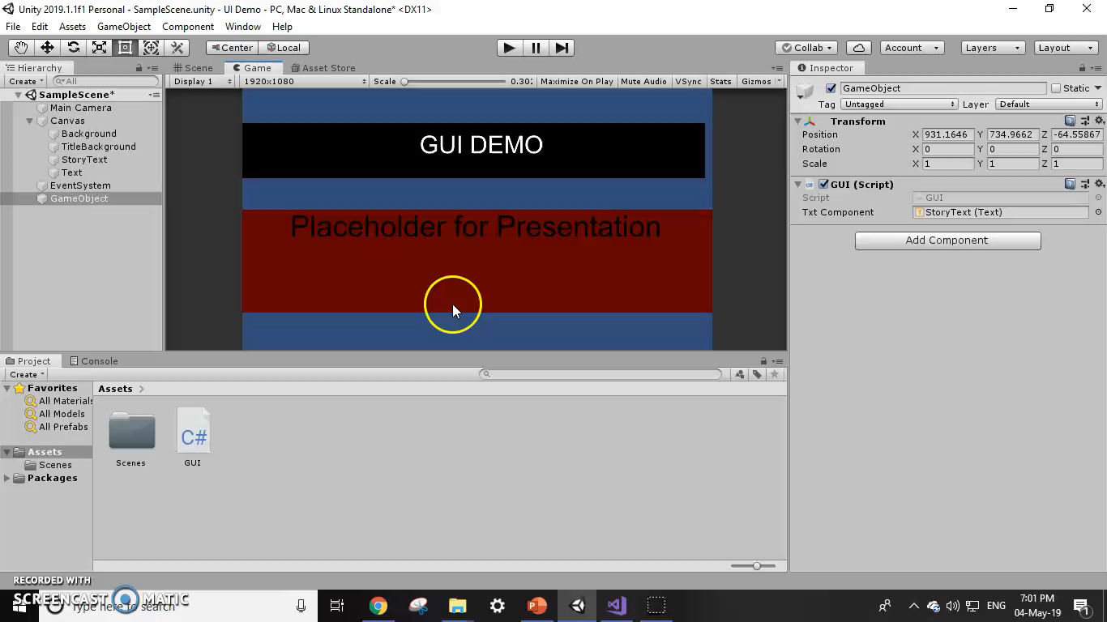
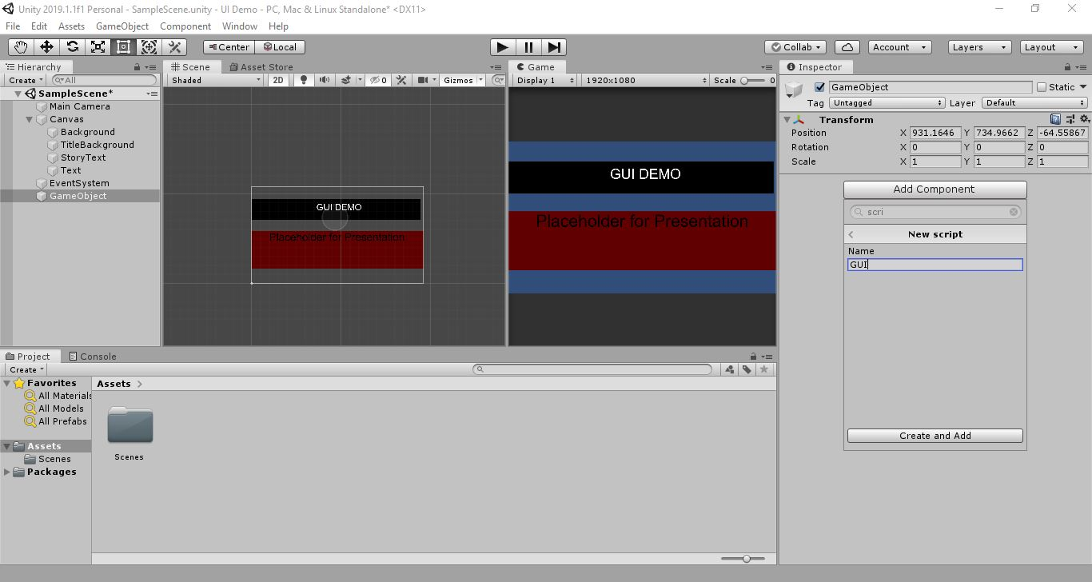
How to use
Scripts

Slide 13
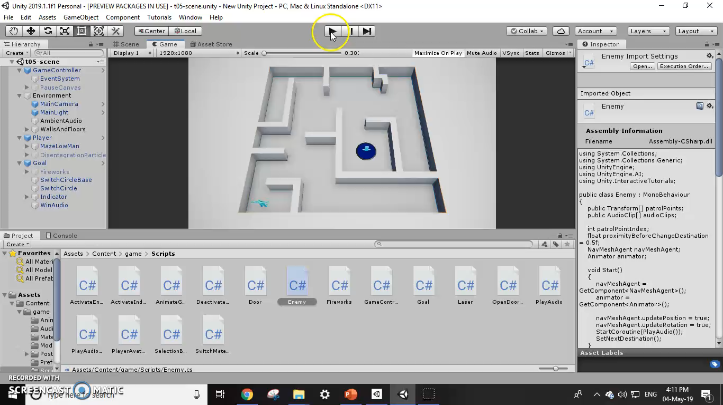
how to use
Final Product

Slide 14
Introduction to unity
How to download
History
How to use
Competitors
General Review

